Slide 1
IOT Instant Contactless Thermal Scanner

Slide 2


HELLO!
THIS IS TEAM TECH PHANTOMS
We welcome you to our Project.

Slide 3
Today, the world is facing the coronavirus crisis, a pandemic that has changed life for millions of people. Many who are locked at home, others who are working to help and prevent the virus, also need the reassurance that “we shall overcome this.”

Slide 4
The Idea
While visiting stores, we have noticed that security guards with thermal guns, often come in direct contact with the customers/visitors, especially when crowds are gathered outside the stores. This can be life threatening for that personnel on duty. To prevent this, an automated device is required which informs the shopkeeper about any abnormality regarding the temperature of any customer.

Slide 5
Covi Prevento
This Project aims to revolutionize
the way of using thermal scanners.

Slide 6
CONCEPT
This project is based on IoT (Internet of things).

Slide 7

INTRODUCTION
It consists of a Thermal Scanner which transmits the status of the temperature of the visiting customer directly to the shopkeeper’s smartphone over WiFi.

Slide 8
Components Required
NodeMCU (Wi-Fi enabled microcontroller), IR Temperature sensor (MLX90614), Jumper Wires, Breadboard

Slide 9
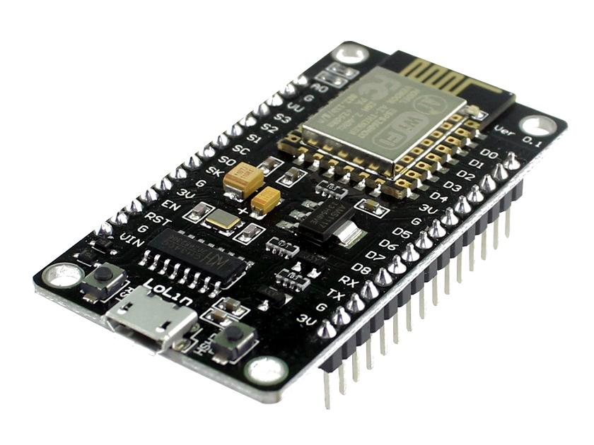
NodeMCU

Slide 10
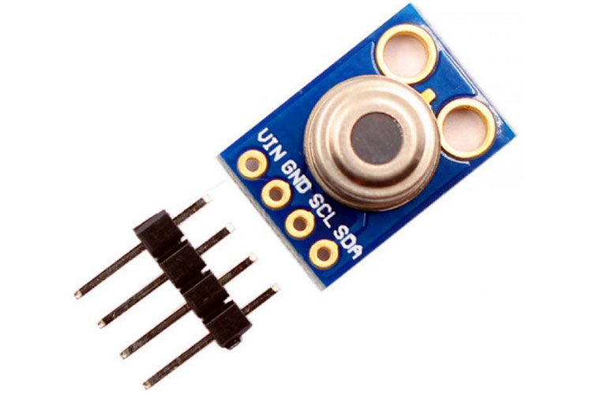
Non-Contact IR Temperature Sensor

Slide 11
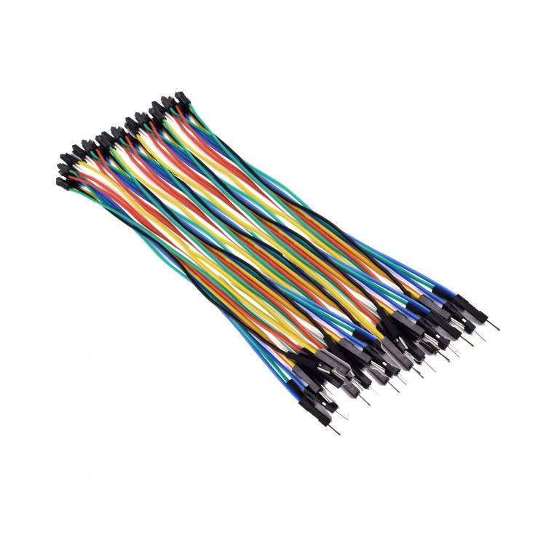
Jumper Wires

Slide 12
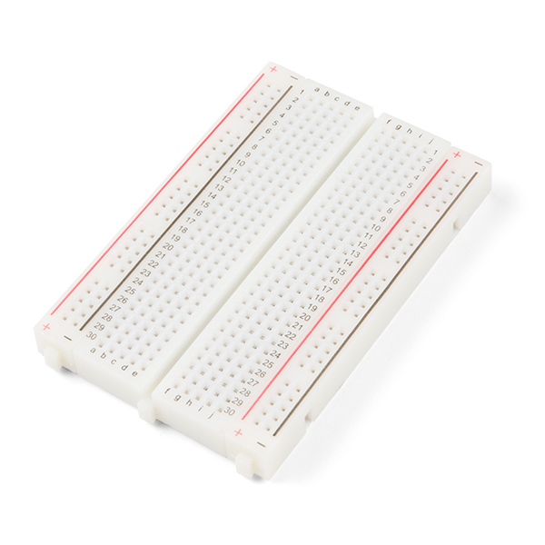
Breadboard

Slide 13

Application used: Blynk

Slide 14

Schematic

Slide 15
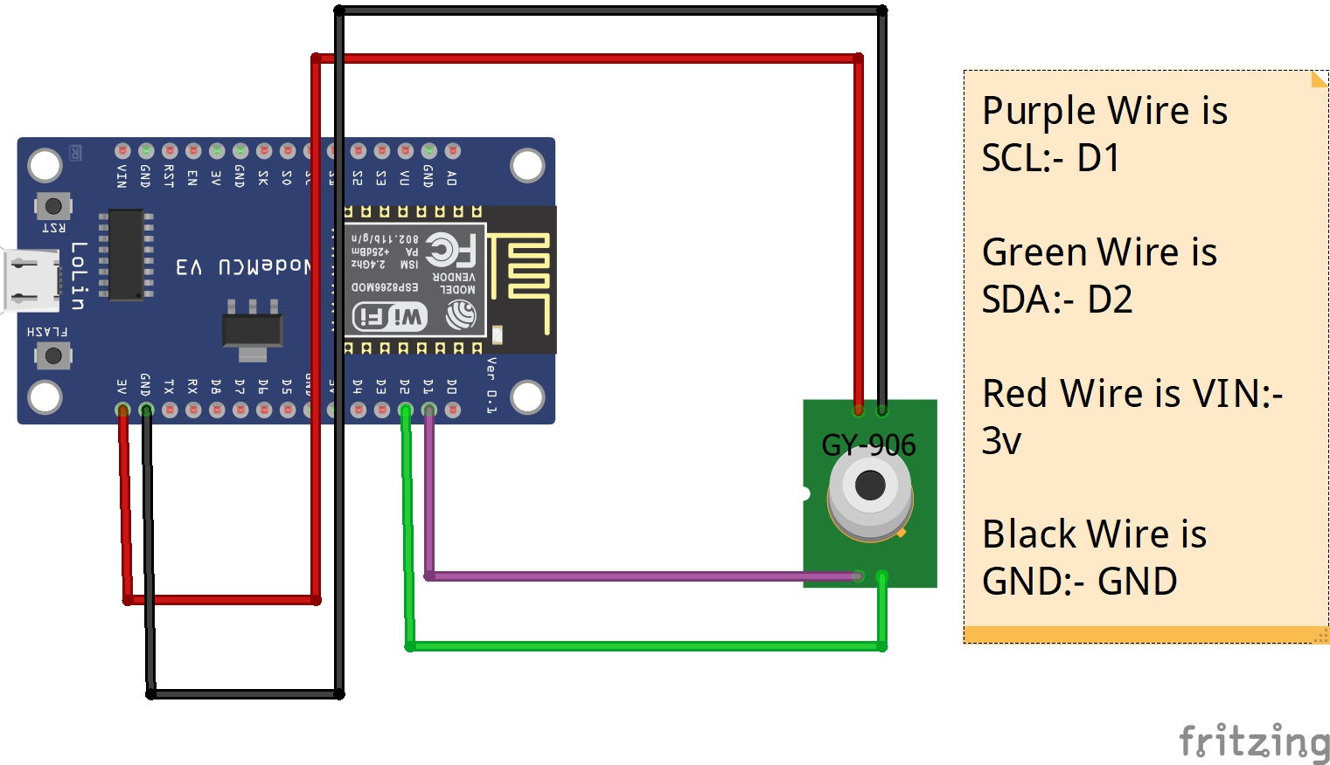
our office

Slide 16
Sample Pictures

Slide 17
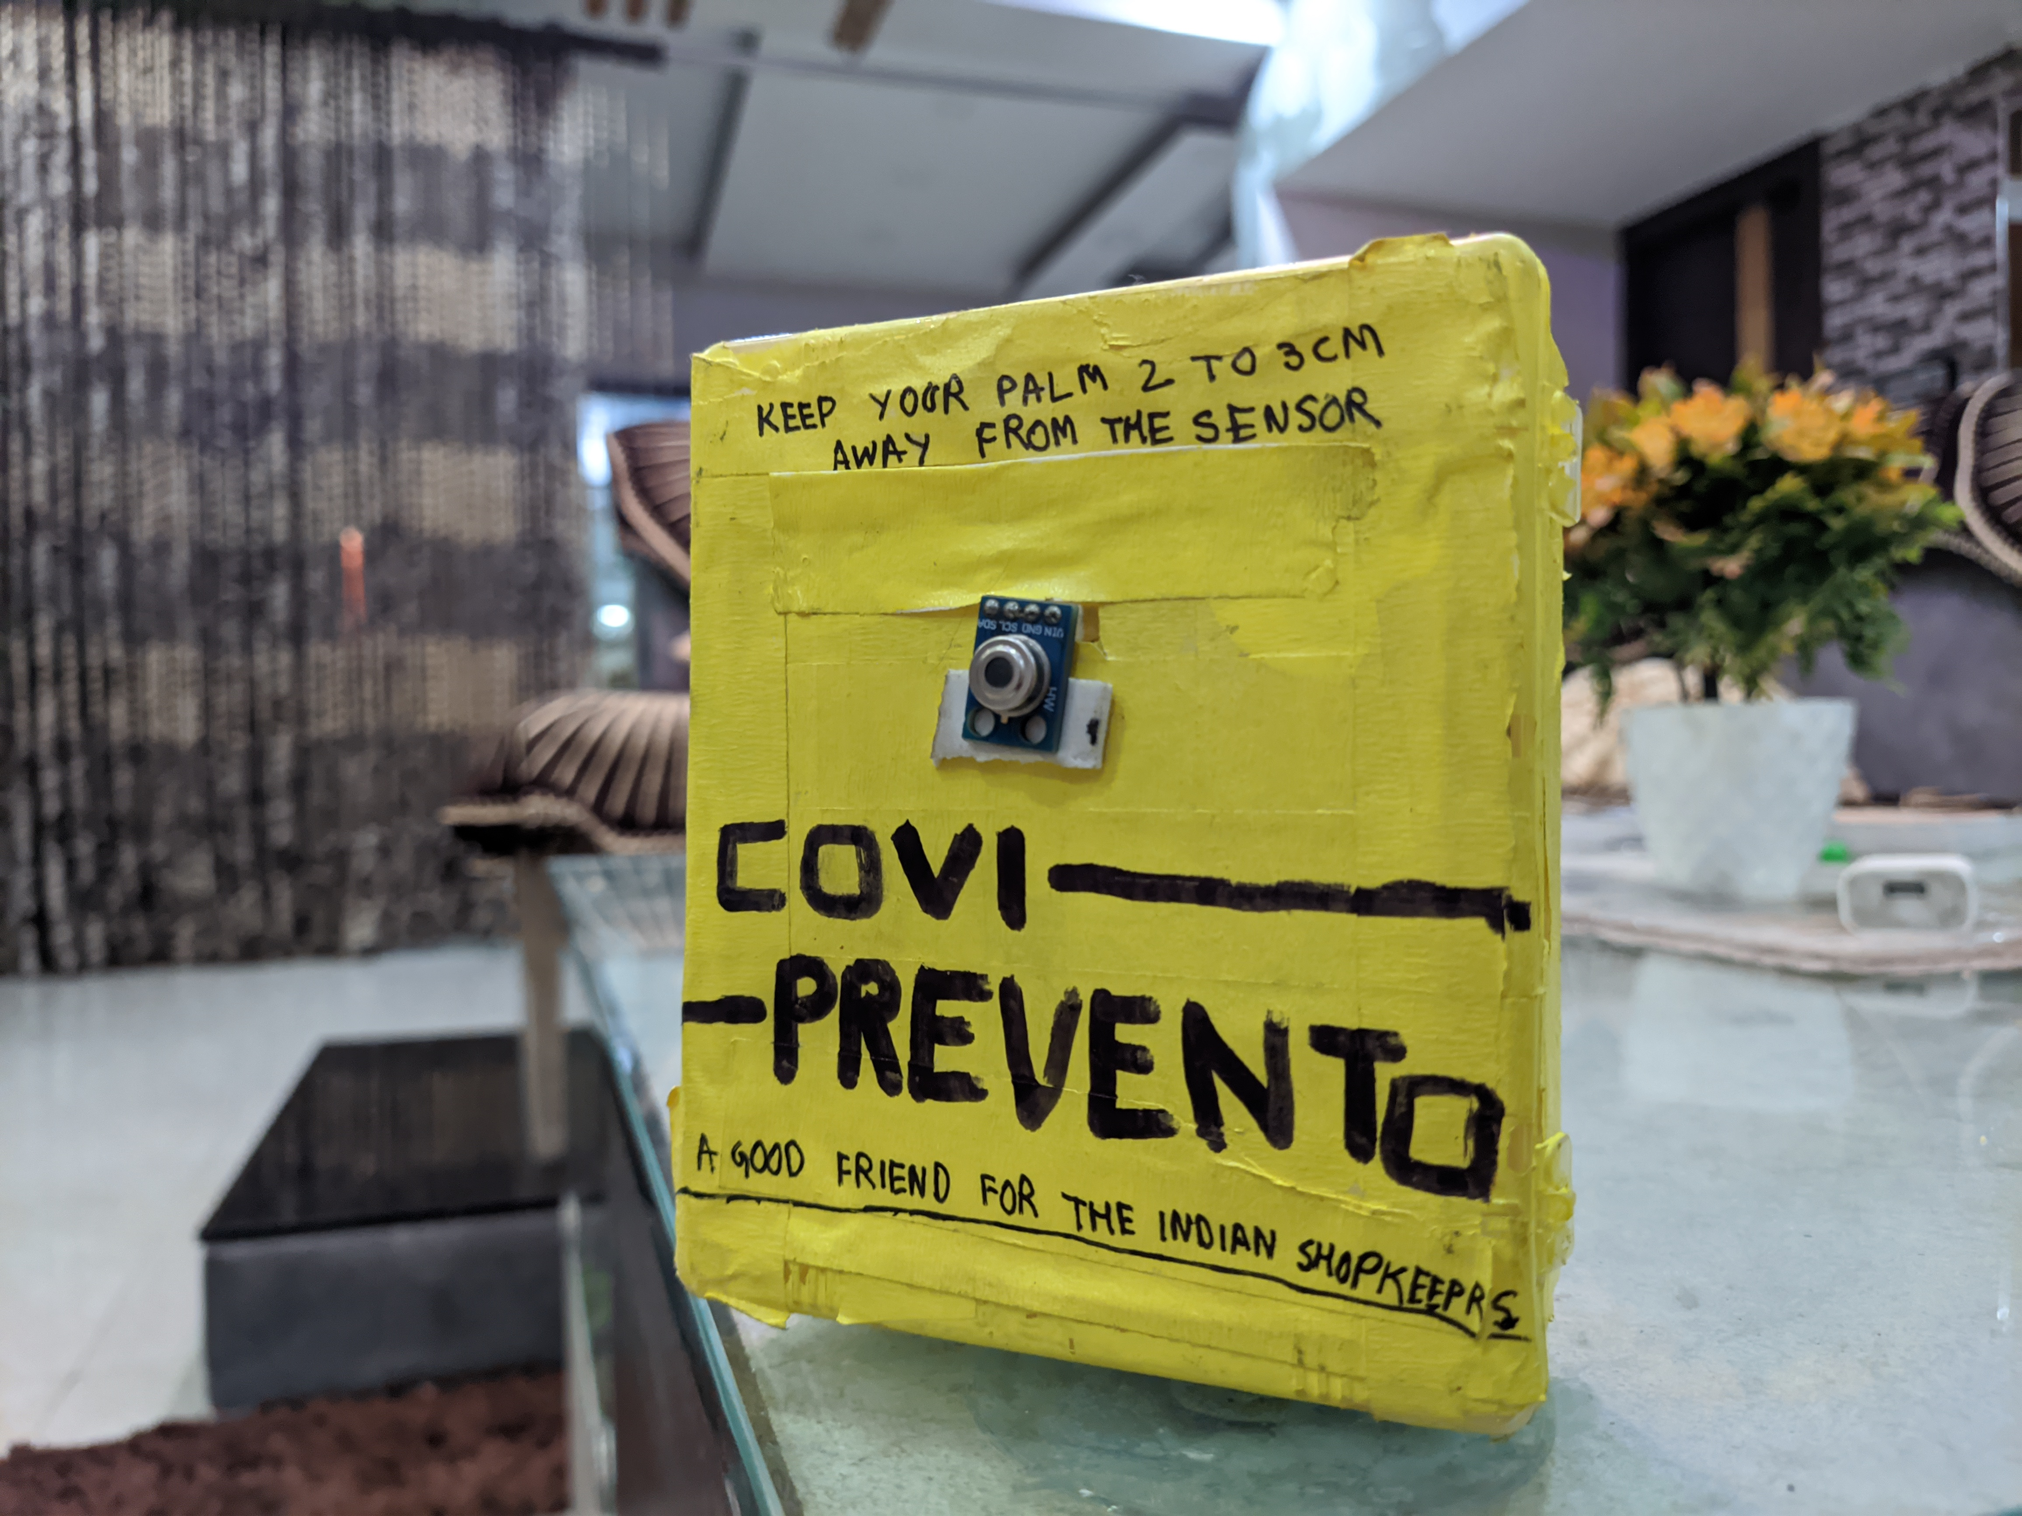

Slide 18
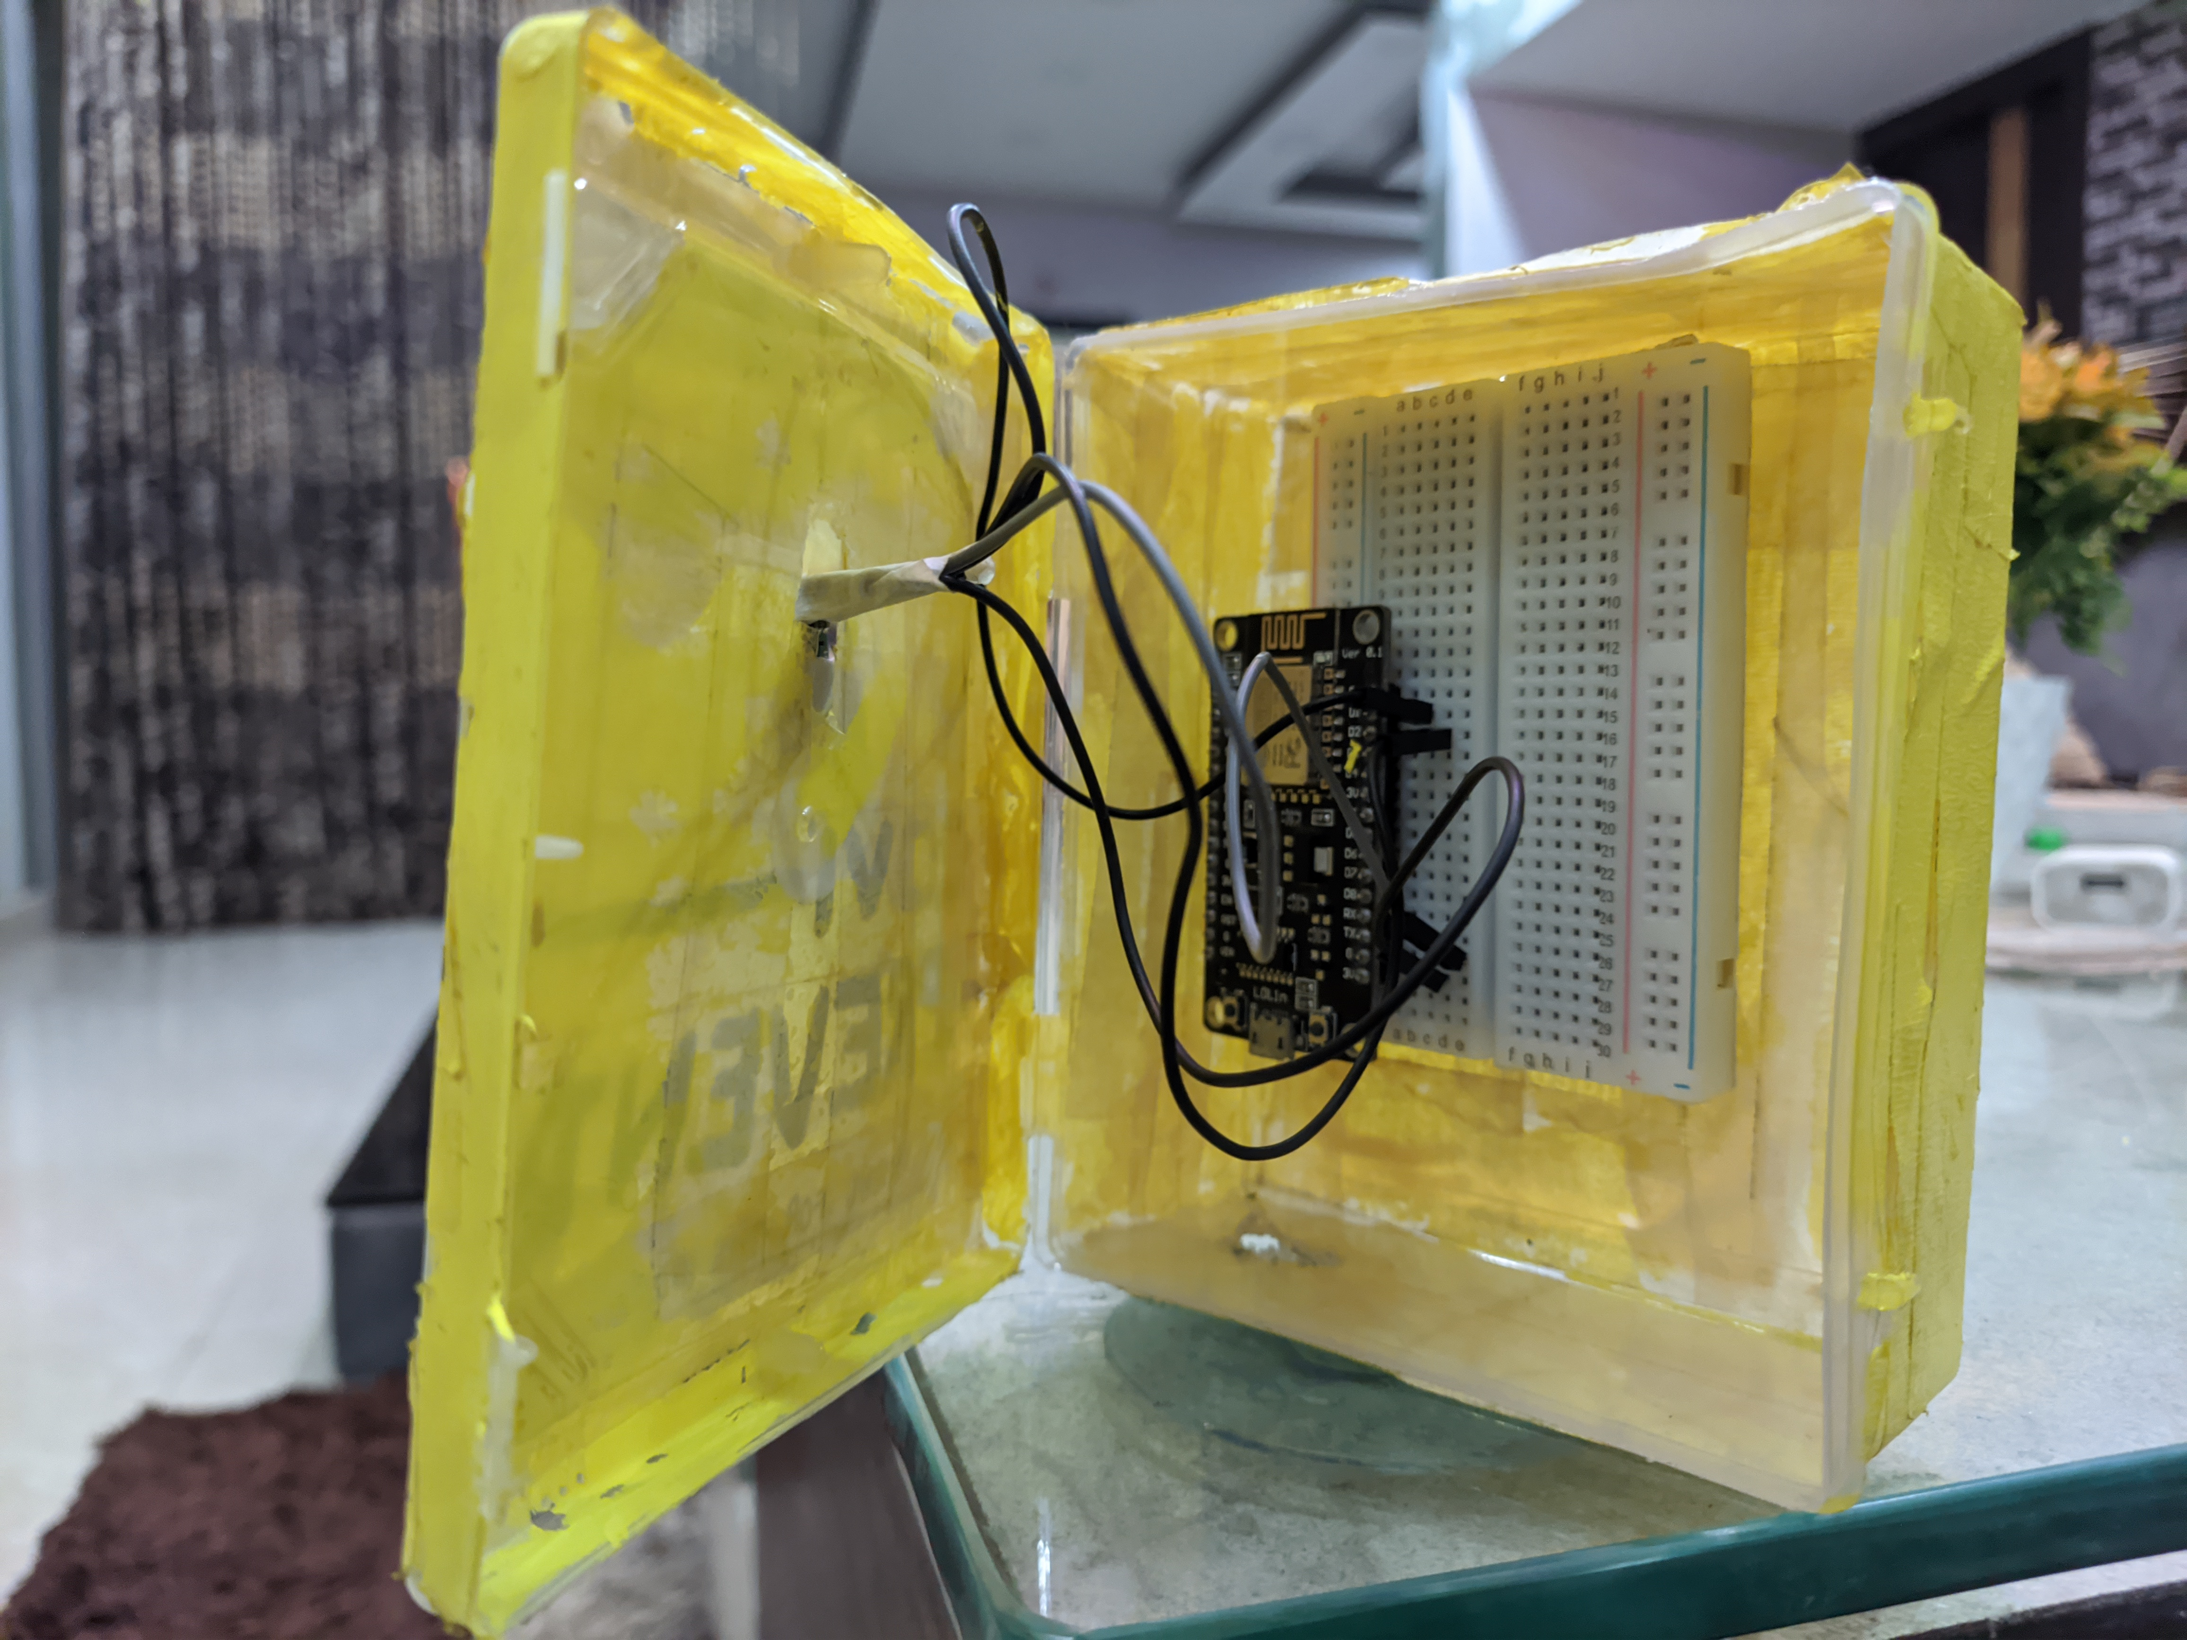

Slide 19
Link to Source Code
https://github.com/RahulBarnwal09/Hackathon

Slide 20
THANKING YOU!

Slide 21


TEAM PRESENTATION
Amritansh Singh ECE 24’
Rahul Barnwal ECE 24’

